Slide 1
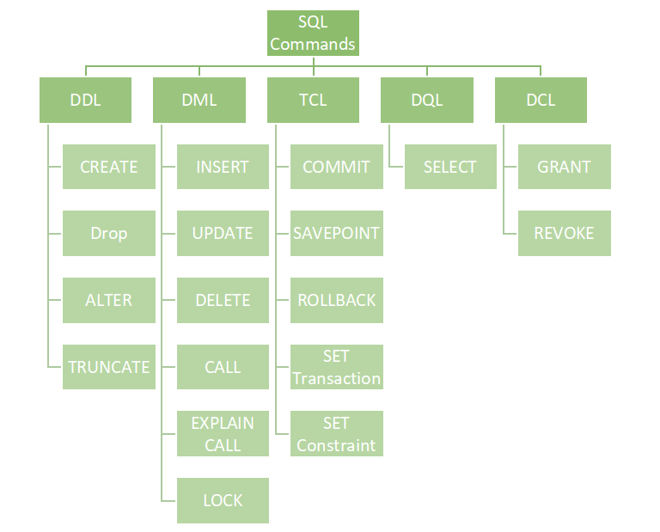

Slide 2
Data Definition Language (DDL):
Used to define the database schema.
Used to create, modify, and delete database structures but not data.
These commands are normally not used by a general user, who should be accessing the database via an application.
List of DDL commands:
CREATE: This command is used to create the database or its objects (like table, index, function, views, store procedure, and triggers).
DROP: This command is used to delete objects from the database.
ALTER: This is used to alter the structure of the database.
TRUNCATE: This is used to remove all records from a table, including all spaces allocated for the records are removed.
COMMENT: This is used to add comments to the data dictionary.
RENAME: This is used to rename an object existing in the database.

Slide 3


Data Manipulating Language (DML):
Manipulate of data present in the database
Includes most of the SQL statements.
List of DML commands:
INSERT : It is used to insert data into a table.
UPDATE: It is used to update existing data within a table.
DELETE : It is used to delete records from a database table
DELETE: chỉ xóa bản ghi ra khỏi Table, có thể khôi phục lại được
TRUNCATE: xóa toàn bộ bản ghi ra khỏi TABLE, và không khôi phục lại được
DROP: xóa luôn table ra khỏi Database
LOCK: Table control concurrency.
CALL: Call a PL/SQL or JAVA subprogram.
EXPLAIN PLAN: It describes the access path to data.

Slide 4

Data Query Language (DQL):
Used for performing queries on the data within schema objects.
The purpose of the DQL Command is to get some schema relation based on the query passed to it.
Allows getting data from the database and imposing order upon it.
It includes the SELECT statement. This command allows getting the data out of the database to perform operations with it.
When a SELECT is fired against a table or tables, the result is compiled into a further temporary table, which is displayed or perhaps received by the program i.e., a front-end.
List of DQL:
SELECT: It is used to retrieve data from the database.

Slide 5
Data Control Language (DCL):
DCL includes commands such as GRANT and REVOKE which mainly deal with the rights, permissions, and other controls of the database system.
List of DCL commands:
GRANT: This command gives users access privileges to the database.
REVOKE: This command withdraws the user’s access privileges given by using the GRANT command.
Though many resources claim there to be another category of SQL clauses TCL – Transaction Control Language. So, we will see in detail about TCL as well. TCL commands deal with the transaction within the database.
List of TCL commands:
COMMIT: Commits a Transaction.
ROLLBACK: Rollbacks a transaction in case of any error occurs.
SAVEPOINT: Sets a save point within a transaction.
SET TRANSACTION: Specify characteristics for the transaction.

Slide 6


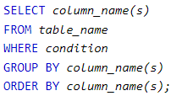
Aliases key word:
Aliases are used to give a table, or a column in a table a temporary name.
Aliases are often used to make column names more readable.
An alias only exists for the duration of that query.
An alias is created with the AS keyword.
Alias Column Syntax
Alias Table Syntax
Group by key word:
Groups rows that have the same value into summary rows.
Often use with aggregate function (COUNT(), MAX(), MIN(), SUM(), AVG()) to group the result set by one or more columns.
Syntax:

Slide 7
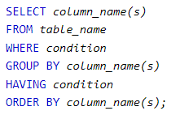

Having key word:
The HAVING clause was added to SQL because the WHERE keyword cannot be used with aggregate functions.
Syntax:
Order by key word:
The ORDER BY keyword is used to sort the result-set in ascending or descending order.
ascending order by default. To sort the records in descending order, use the DESC keyword.
Syntax:

